Slide 1
JJAX AN NFT Based Music Sharing Platform
Group 12 – Andrew McWilliam, Jake Grieves, Jaiyi Zhong and Xinrui Hue

Slide 2

Intro
Topic one
Topic two
Topic three
Topic four

Slide 3

Introduction
Modern technology has revolutionised the streaming, distribution and sale of music, making it easier and more efficient than ever before.
And yet these developments have brought with them their own unique set of challenges – lack of platform transparency, lack of artist autonomy and high barriers to entry in the form of fees and restrictions.
Is there an overarching source to these problems, are these challenges symptoms of a wider issue?
Notes:
The advent of music streaming platforms revolutionised music consumption but also introduced problems like high fees, restricted content access, and challenges for non-mainstream creators. To address these, the report discusses the development of a decentralized streaming music platform, JJAX, built on Ethereum, leveraging smart contracts, tokenization, and NFTs. This platform ensures a more open, transparent, and fair revenue sharing environment for creators. They can freely upload music, set their own prices, and receive most of their earnings in cryptocurrency. The platform also encourages secondary creators to remix and upload their creations, ensuring original creators also profit. Listeners can discover and purchase music at a lower cost. The report outlines the background, motivation, architecture, and technical details of JJAX, evaluates its effectiveness, and discusses potential improvements. In essence, JJAX is poised to disrupt the industry, providing a fairer, more sustainable model for music consumption

Slide 4
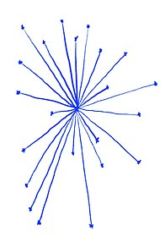
Centralisation

Slide 5



Common streaming music platforms
These are common music apps, but their common problem is that they have too high a fee for the creator and less profit for the creator

Slide 6
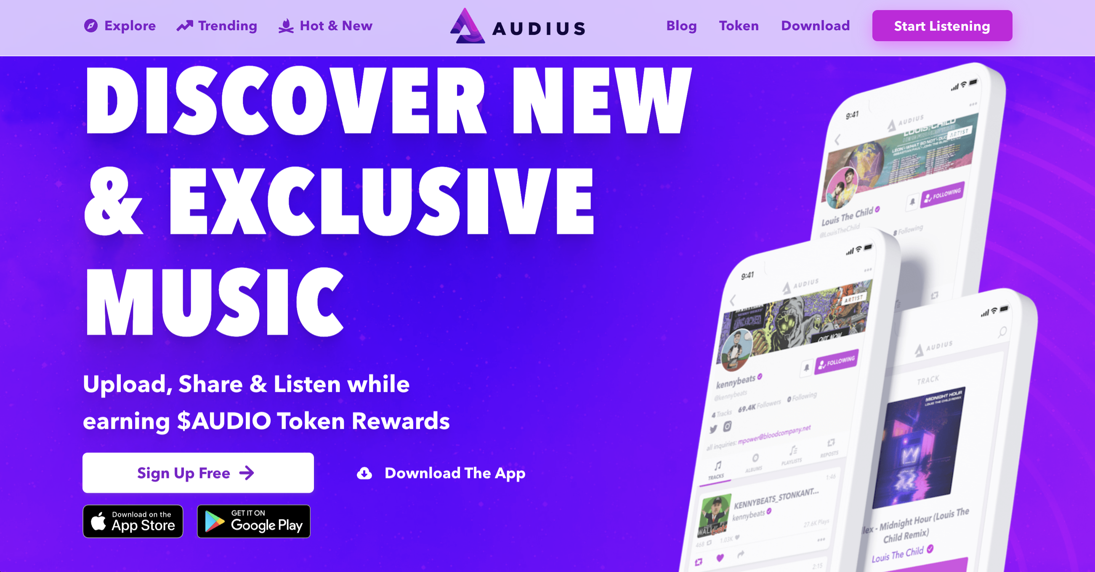
Music Dapp: AUDIUS
It is a platform for decentralised music sharing and streaming protocols：
creators can communicate directly with their fans.
creators receive most of benefits created by their work.
The unique NFT gating feature allows only token holders of the corresponding collection to access the creators' NFTs

Slide 7
Problems with Web 2.0 streaming & distribution
Lack of transparency: The entities controlling these services hold most of the information about revenue generation and distribution, making it hard for artists to verify whether they're receiving a fair share.
Limited control for artists: With control concentrated in the hands of a few, artists often have little say over their work's distribution, including how it's used and priced.
High barriers to entry: Centralised services often impose high costs and strict requirements, making it challenging for emerging artists to join these platforms.

Slide 8
Our Idea
Our decentralised music distribution platform JJAX, attempts to solve these problems through the application of blockchain technology.
Providing free music file uploading services, enabling original creators to upload their music to our platform, set their own prices, and receive the majority of their earnings in cryptocurrency when other users purchase their music
Built on Ethereum, using smart contracts, tokenisation and NFTs to provide a more open and transparent environment for all users.

Slide 9

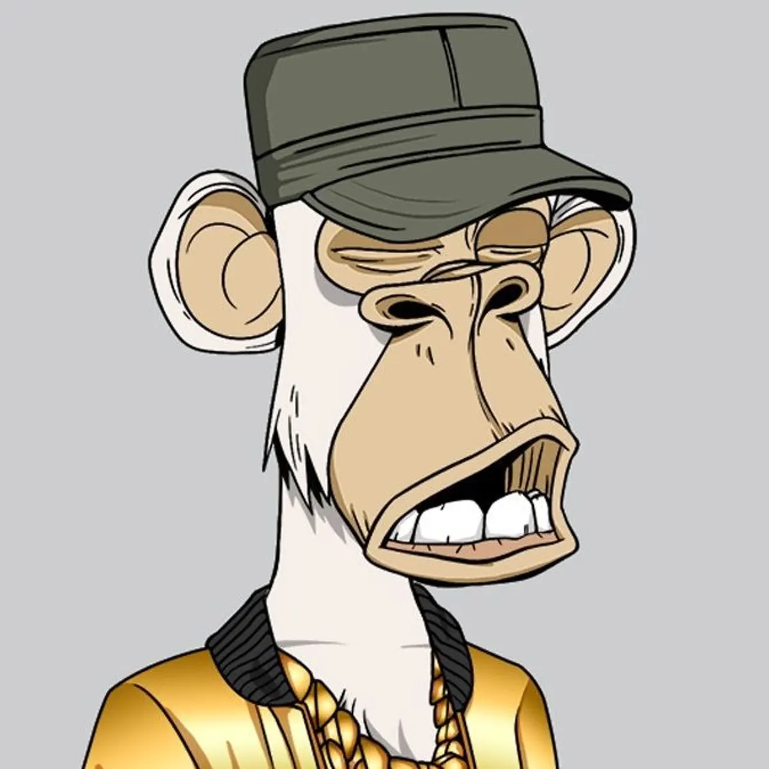

Background Technology
The project is heavily based on the ERC 721 “Non-Fungible Token Standard”
OpenZeppelins’ implementation is used by the project through inheritance.
IPFS is used to host the song metadata

Slide 10
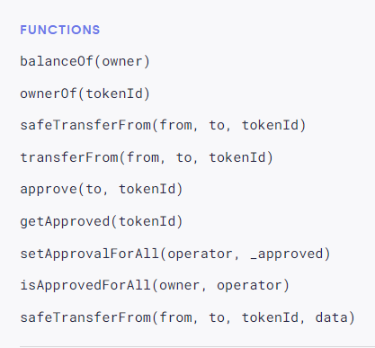
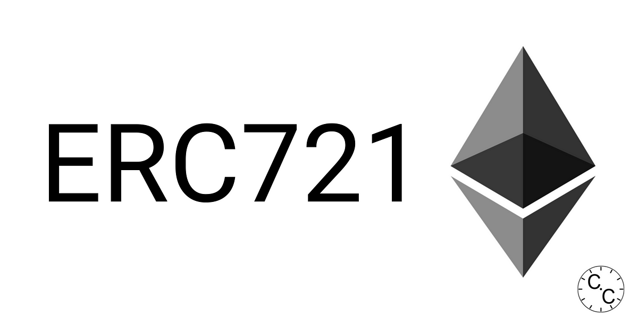
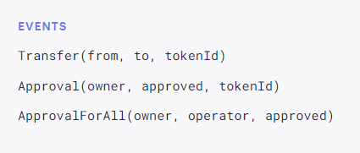
The “Non-Fungible Token Standard”
Inspired by the ERC 20 standard
provides basic functionality to track and transfer NFTs.
Shown are the requirements for an object to be ERC 721 Complacent

Slide 11
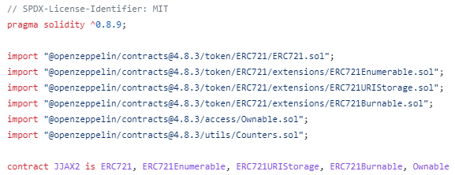
OpenZeppelin is an open-source framework and library for building secure and audited smart contracts on the Ethereum blockchain.
Contains an implementation of the ERC 721 standard (and extensions), which are used by the project.
The project makes use of five base contracts for added functionality.
ERC721.sol
Ownable.sol
Counters.sol
Enumerable.sol
URIStorage.sol
Burnable.sol

Slide 12

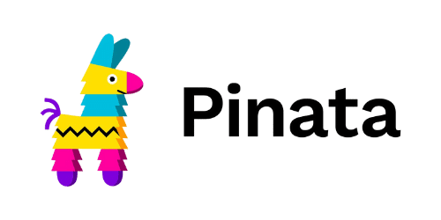
IPFS
“A peer-to-peer hypermedia protocol designed to preserve and grow humanity's knowledge by making the web upgradeable, resilient, and more open.”
Decentralised File Sharing Platform Perfect for our needs in the project.
Each piece of content is identified by a unique hash.
Third party applications are used to upload and view data.

Slide 13

Backend Design
JJAX’s backend architecture was designed in the aim of fulfilling the following objectives –
Enable users to mint their own Non-Fungible Tokens (NFTs)
- Of the ERC721 standard previously discussed.
Allow users to list an NFT in one of two ways –
- A fixed price listing, where the lister defines the minimum price they would be happy with exchanging the NFT they own
- An auction based listing of specified minimum starting price and period of activity, where during this period, other users can input bids in the aim of claiming ownership over the particular NFT.
Allow users to buy fixed priced listing and participate in active auctions.
Allow users to view current listings, separated by their distinct type.

Slide 14
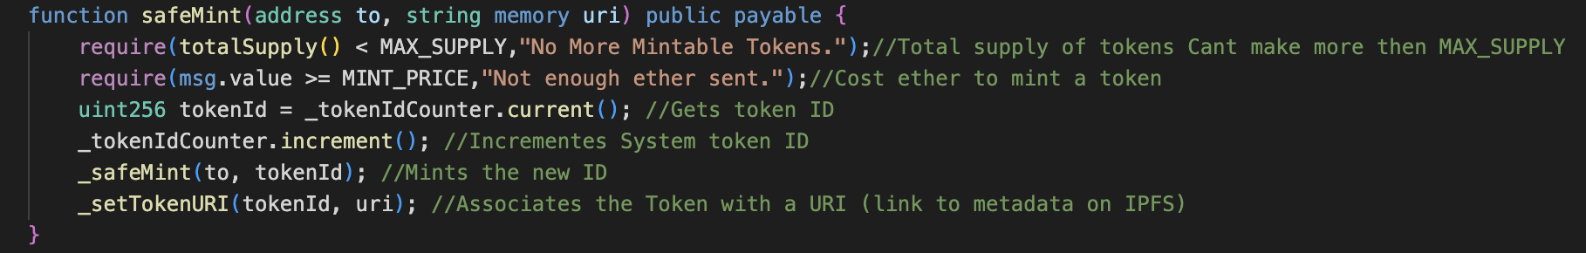
Backend Design, Initial Minting of NFT
As a team, we iterated upon the existing safeMint function from OpenZepplin in order to mint NFTs native to our platform and requirement.
So long as conditions involving maximum supply and mint price are satisfied, the function mints / creates a NFT and assigns it a tokenID and token URI, linking it to data stored on IPFS.

Slide 15
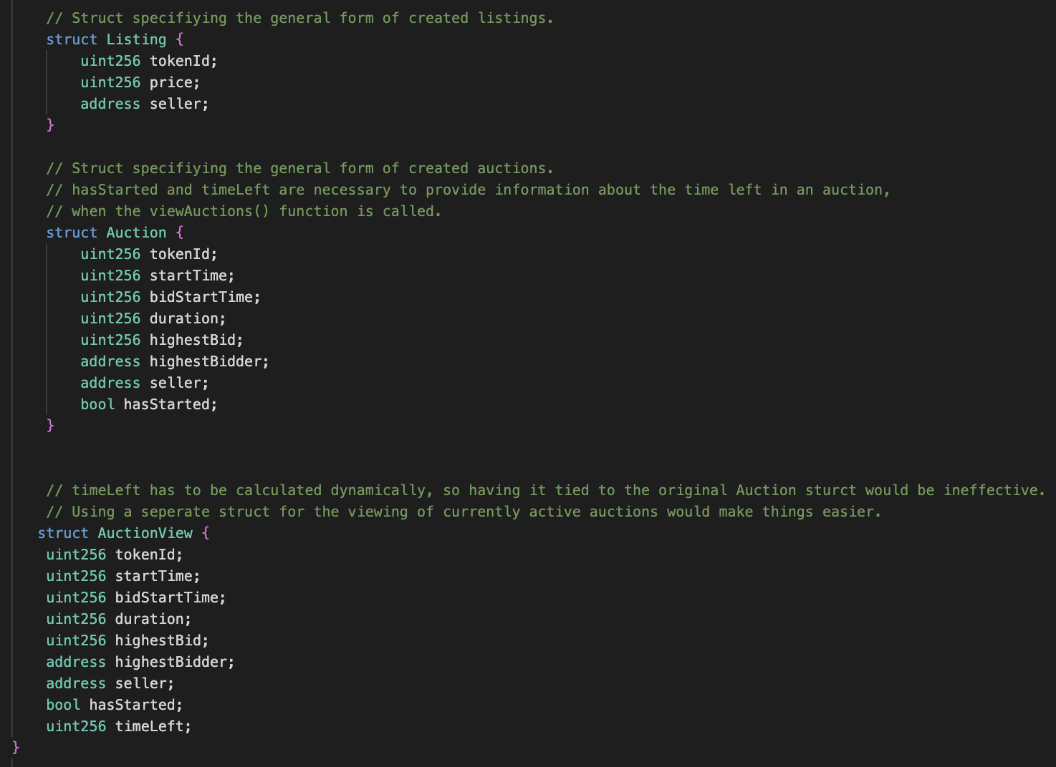
Backend Design, Structures
Each struct represents the general form of fixed price listings and auctions listings, while active, which are used to represent various types of information in a structured format:
Listing, describing tokenID, asking price and seller address.
Auction, containing much of the same information as the Listing Struct, but additional variables describing the state of the auction, like bidStartTime and timeLeft.

Slide 16
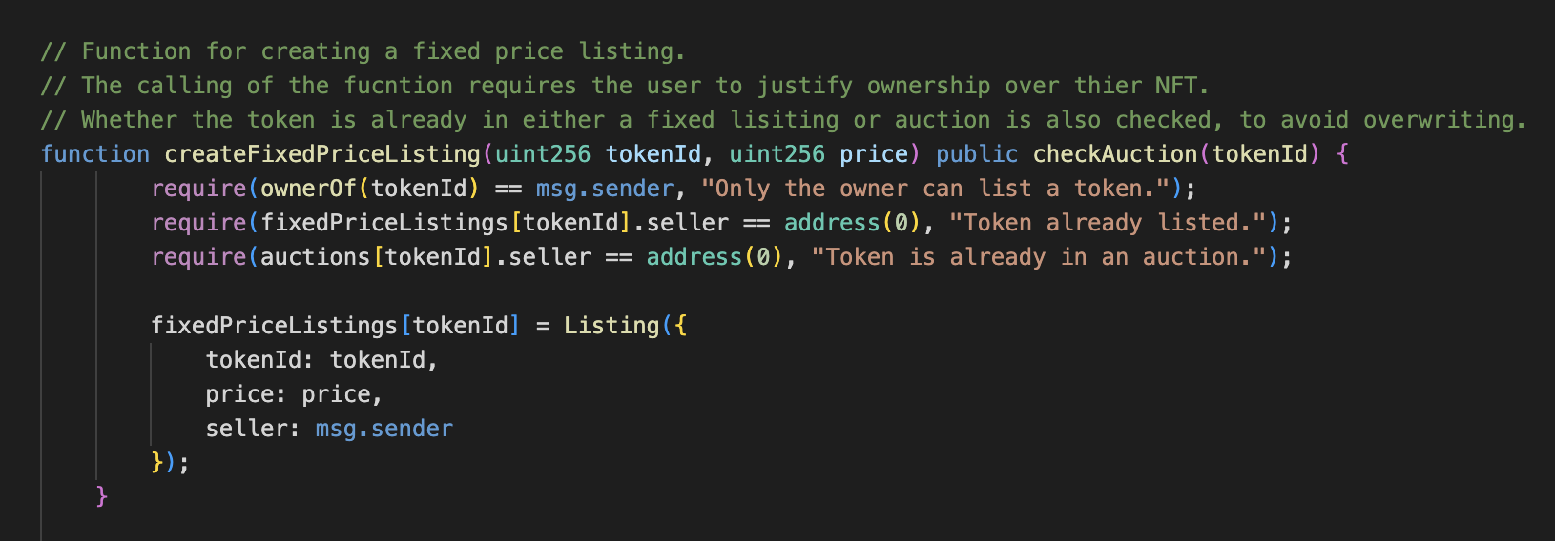
Backend Design, Creation of Fixed Price Listing
Instances of the Listing struct can be made to create a new fixed listing.

Slide 17
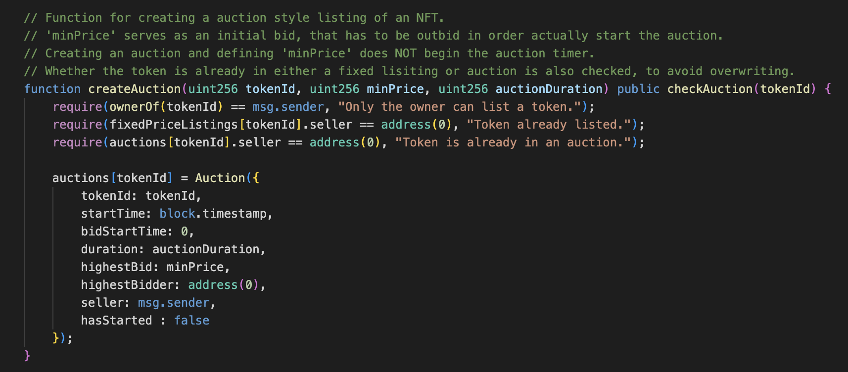
Backend Design, Creation of Auction Based Listing
Similarly, instances of the Auction struct can be made to create a new auction based listings.

Slide 18
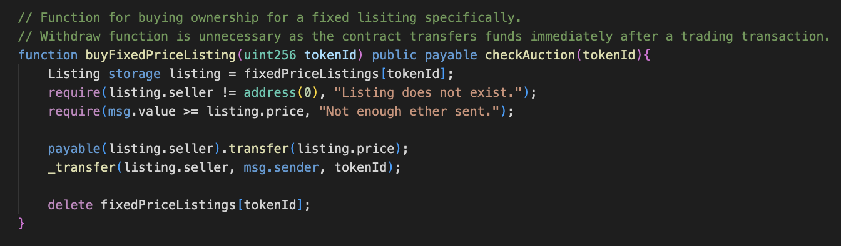
Backend Design, Buying a Fixed Price Listing
If the listing still exists and a sufficient amount of ether is sent, then ownership of the NFT is transferred and the sender and the address associated with the NFT reassigned.

Slide 19
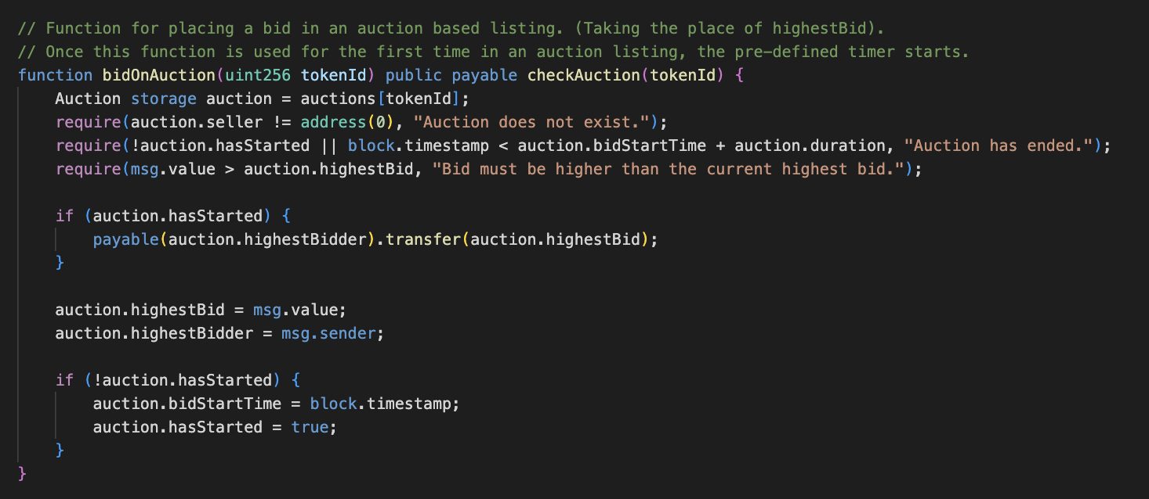
Backend Design, Buying an Auction Based Listing
A user to place a bid on an auction for a specific token ID, as long as the auction exists and is still active, and the new bid exceeds the current highest bid. The bid replaces the current highest bid and the timer for the auction begins if it has not already started.
If a higher bid is placed during an ongoing auction, the previous highest bidder gets their bid amount refunded.

Slide 20
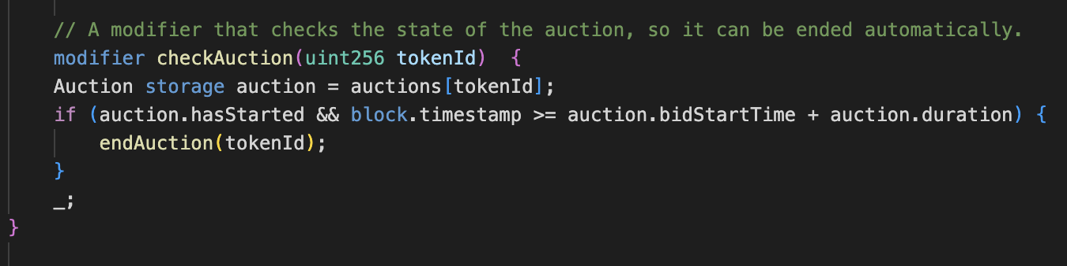
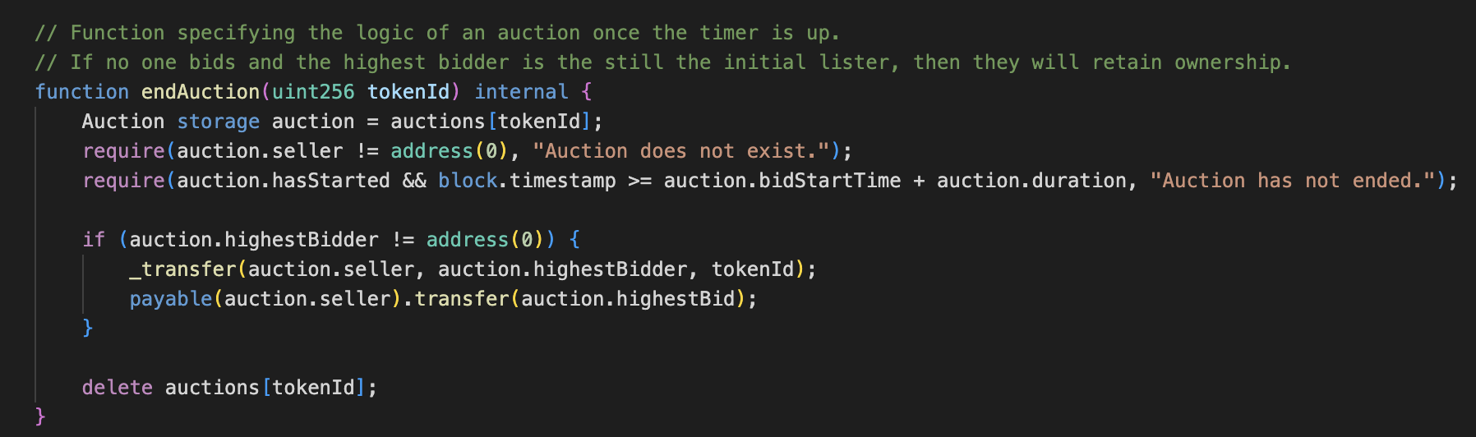
Backend Design, Mechanism for Concluding Auction
The modifier checkAuction and endAuction work in conjunction to manage the lifecycles of auctions.

Slide 21
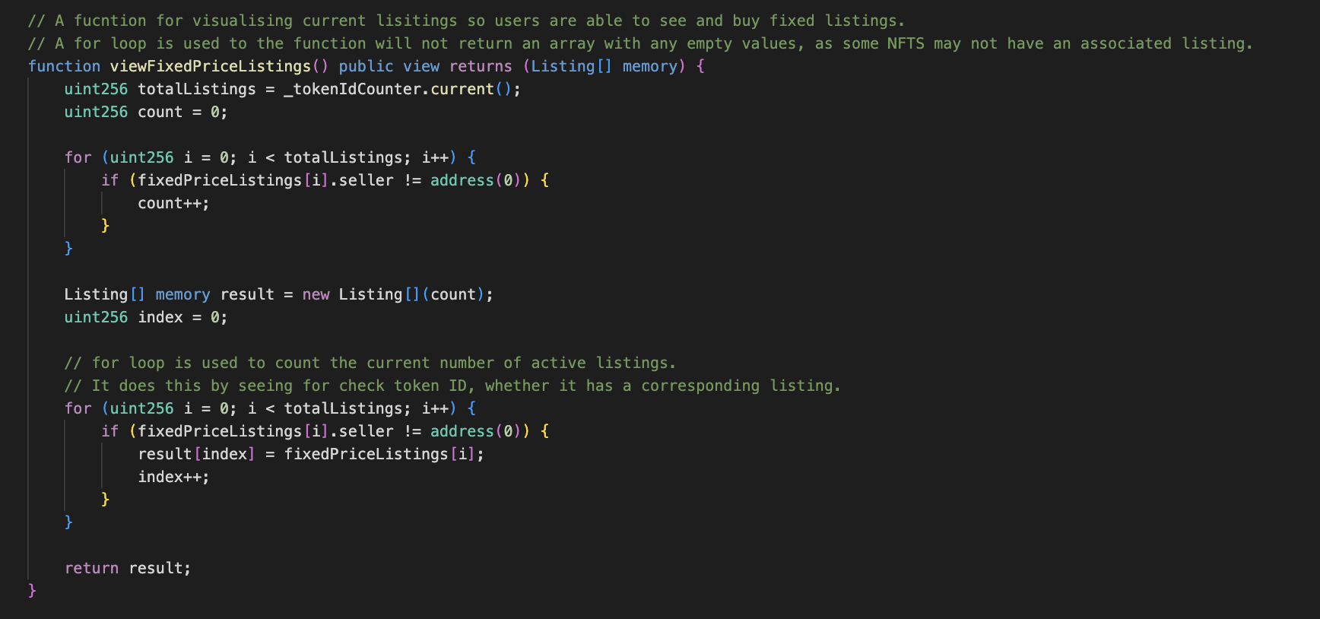
Backend Design, Presenting Active Fixed Price Listings
The function returns an array of Listing structs currently active in the marketplace. It does this by looping through all possible token IDs and checking if there is an active fixed price listing for each one. If there is, it adds this listing to a dynamically-sized result array which it returns at the end.

Slide 22
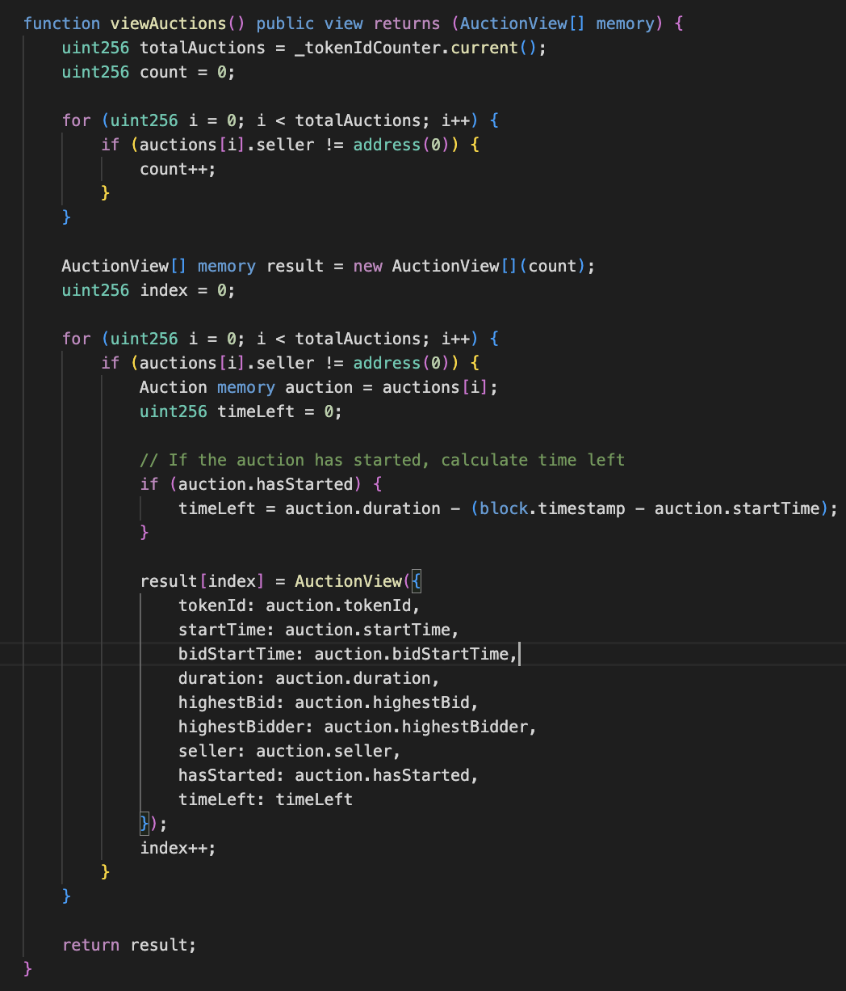
Backend Design, Presenting Active Auction Listings
An array of active items in the marketplace is also returned, but for auctions instead. This function loops through all possible token IDs and checks if there is an active auction for each one.

Slide 23
Front End
Responsible for facilitating the backend through user enabled interactive functionality –
Allow users to upload their art or music, and upload their generated NFT to the network.
Allowing the user to view NFTs , as well as other active listings.
Facilitate the buying and transfer of NFTs, through connecting wallets through the MetaMask API.

Slide 24
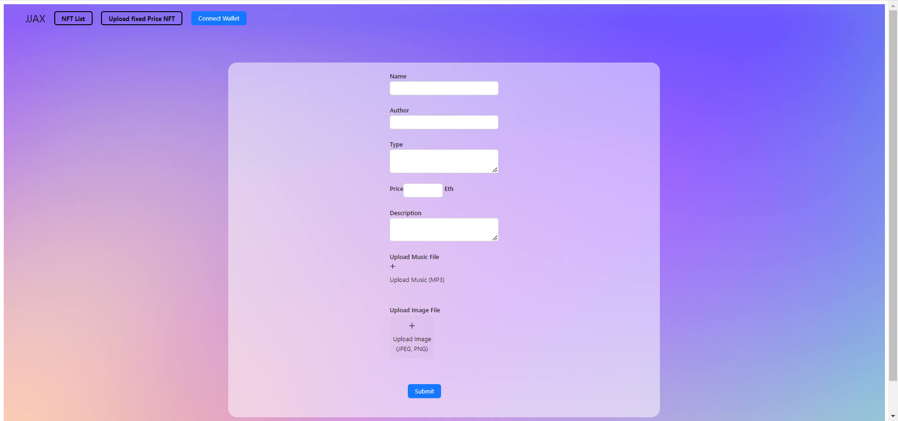
Front End, Upload Functionality

Slide 25
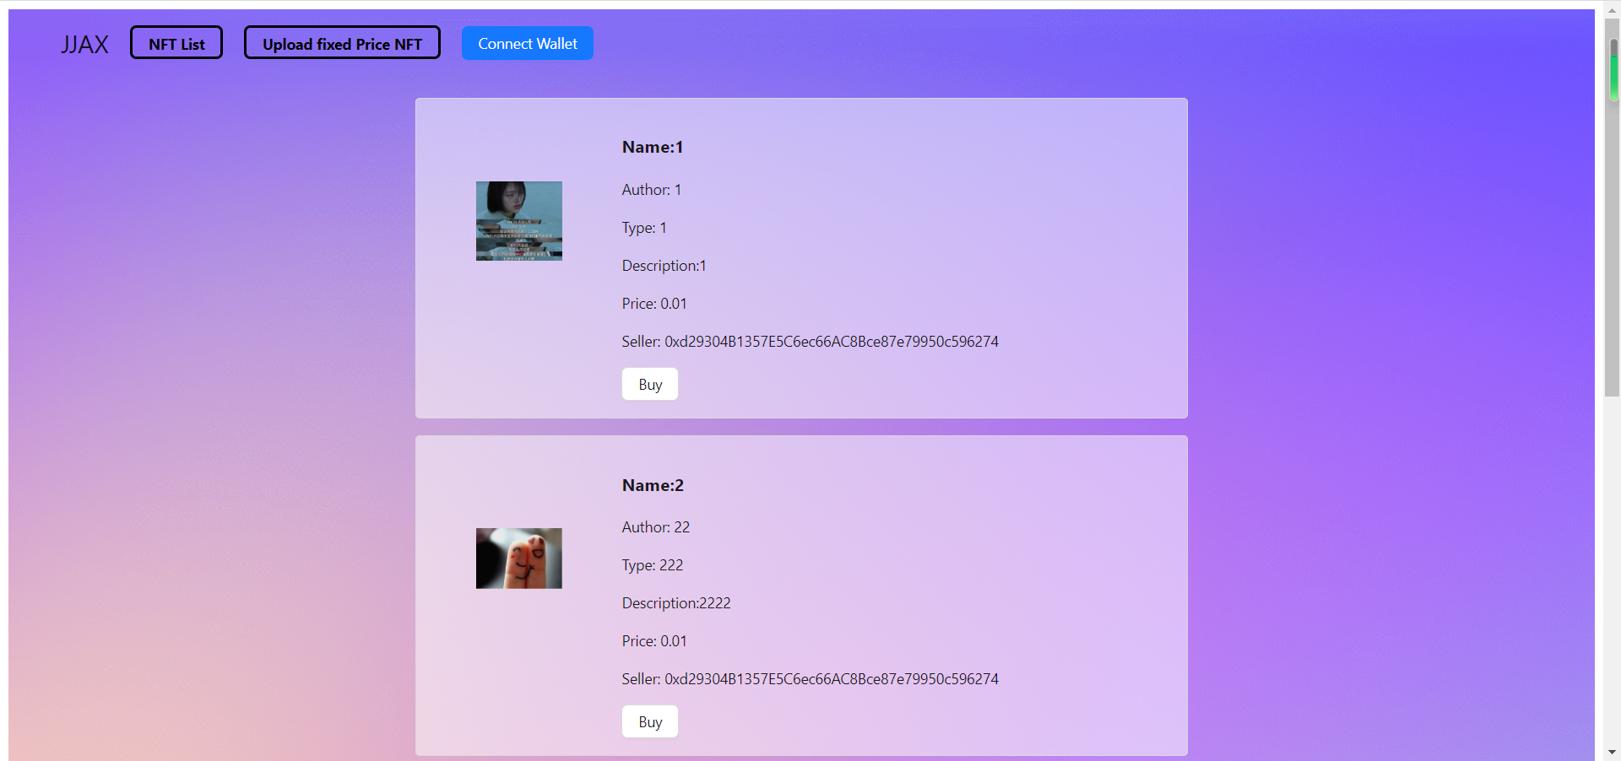
Front End, NFT list

Slide 26
Front End, Continued

Slide 27
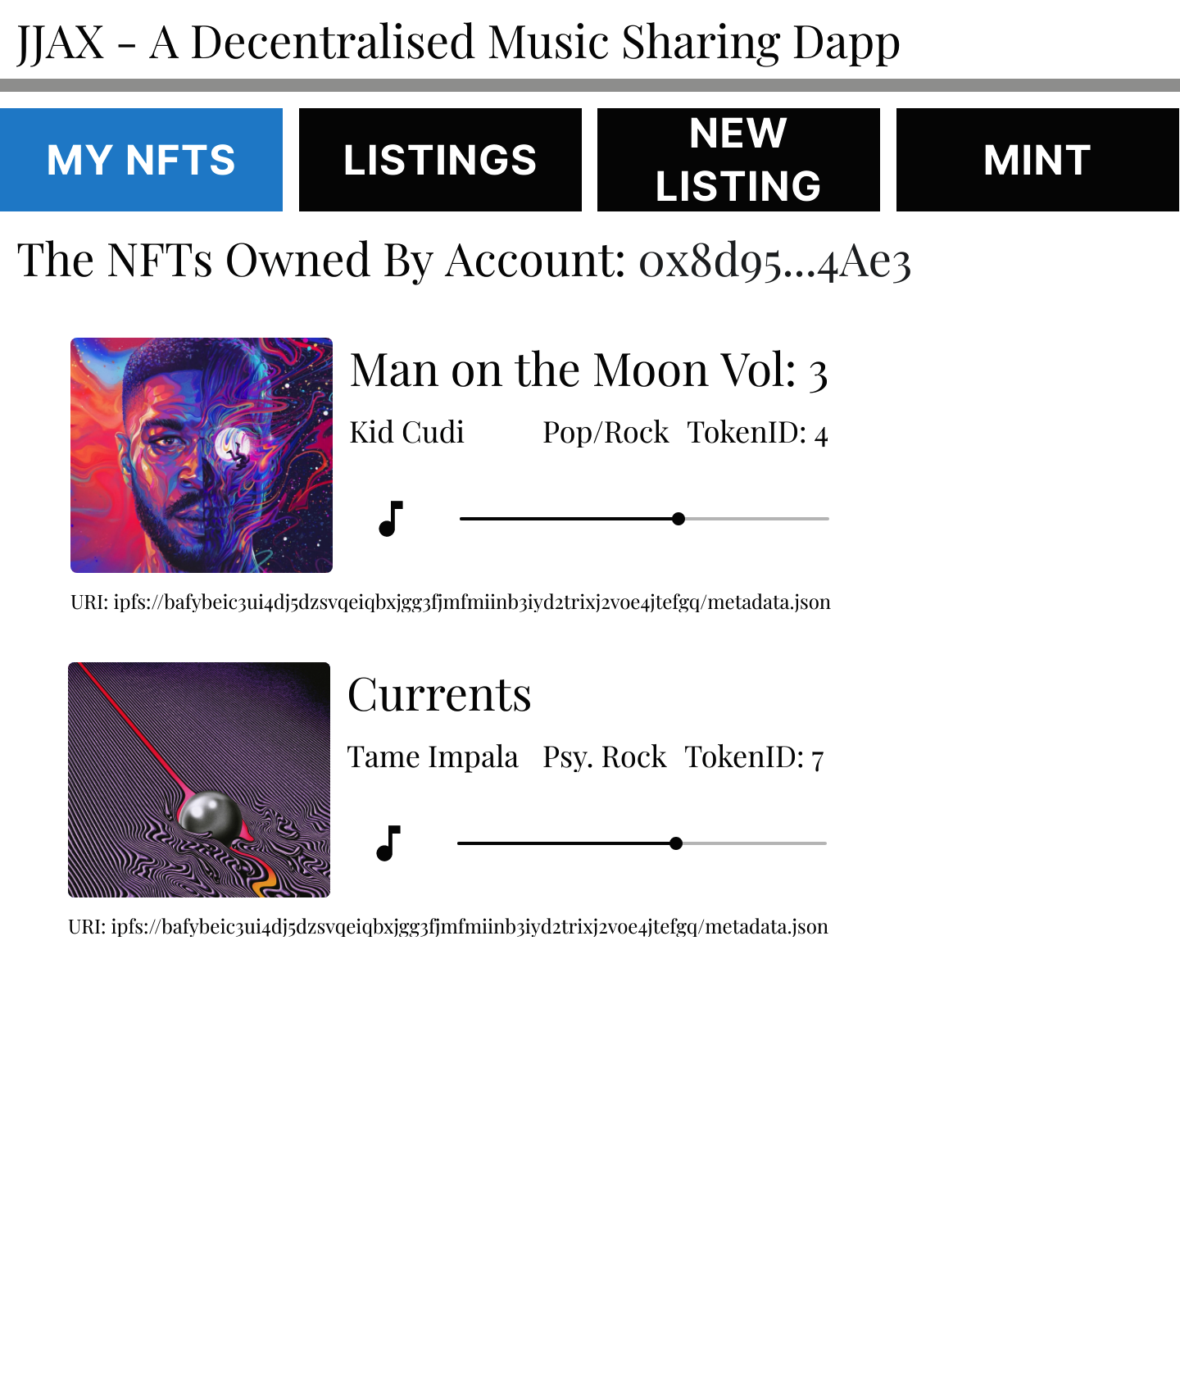
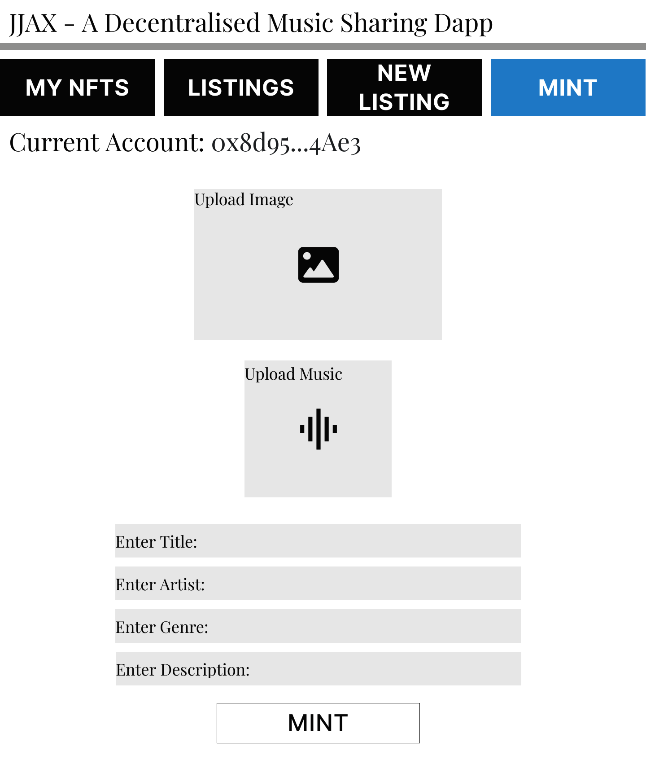
Front End Demo, Ownership & Minting

Slide 28
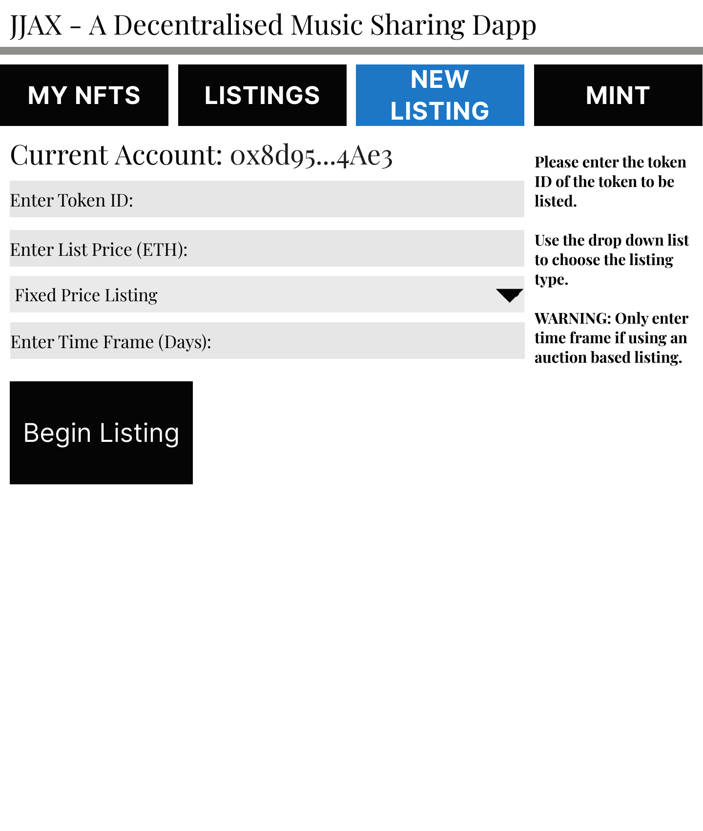
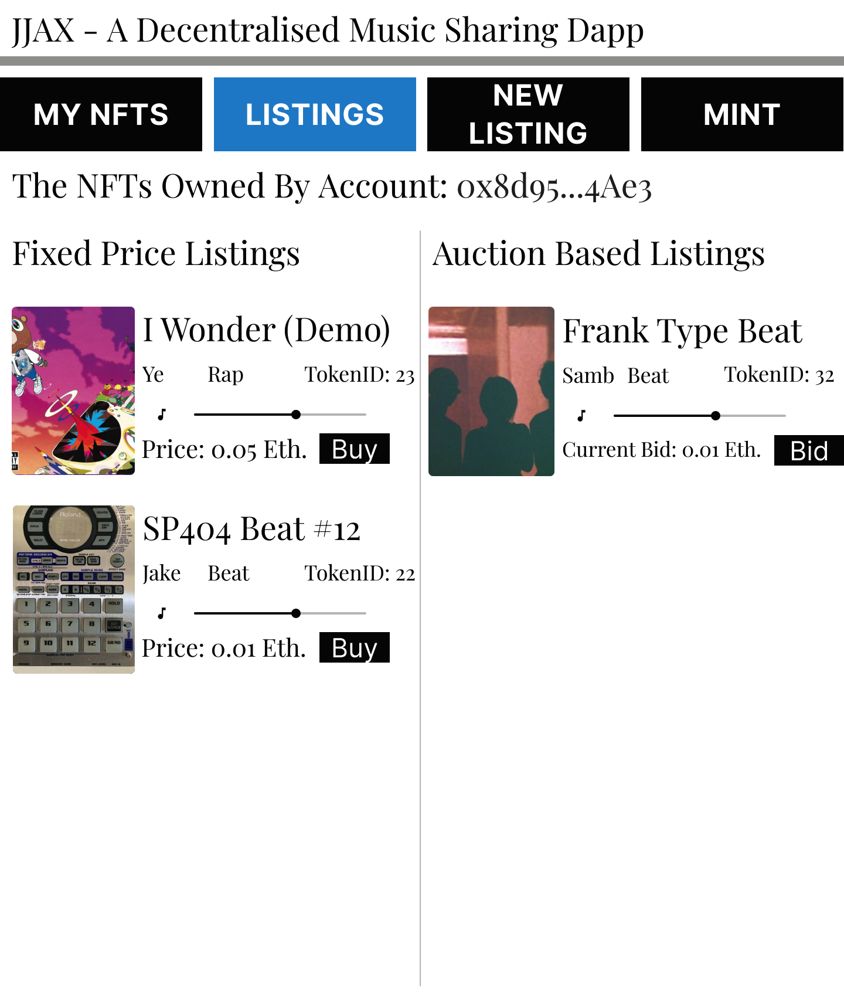
Front End Demo, Creating & Viewing Listings

Slide 29



Future Scope
Deployment to the Ethereum Mainnet
ERC 1150 Token Standard
OpenSea integration
Steganography techniques.

Slide 30




Thank you

